Slide 1
Problems and Issues in
de novo Assembly
BIOF 520 | Dr. Inanc Birol’s session

Slide 2
Order of Discussion
De Bruijn Graphs (Matt)
Scaffolding Algorithms (Ben)
Greedy Algorithms (Rachelle)
SGA & Fermi Algorithms (Golnaz)
Hybrid Assembly (Shams)
Sequencing Methodologies and Error Correction (Jasleen)
CNVs, SegDups, Coverage Bias (GC etc.) (Sam)
Ploidy and Haplotype Differences (Phil)
Homopolymers, Repeats, Palindromes (Prasath)
Contamination and mtDNA (Tony)
Notes:
1 slide each, 10 minute discussion (presentation + Q&A)

Slide 3
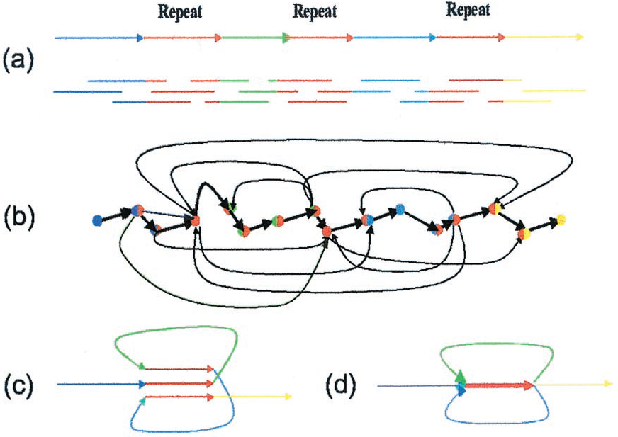
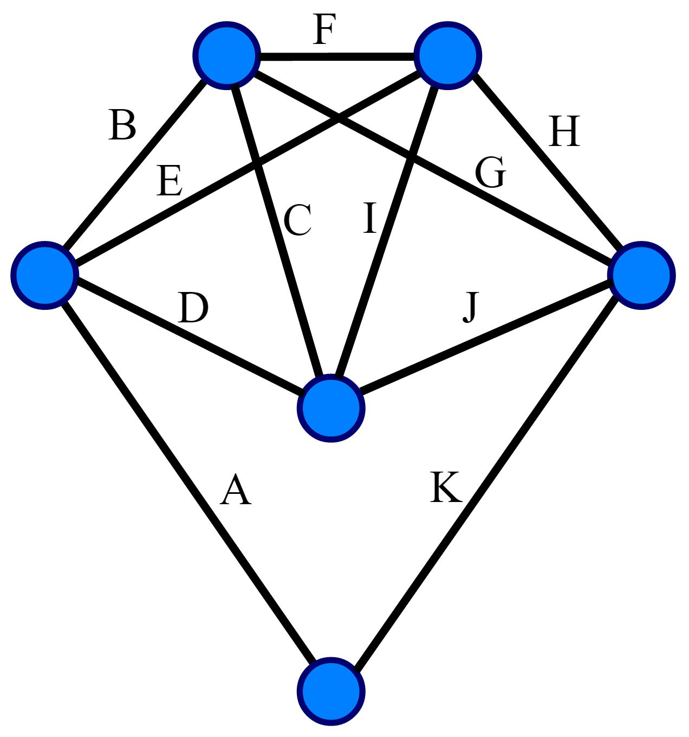
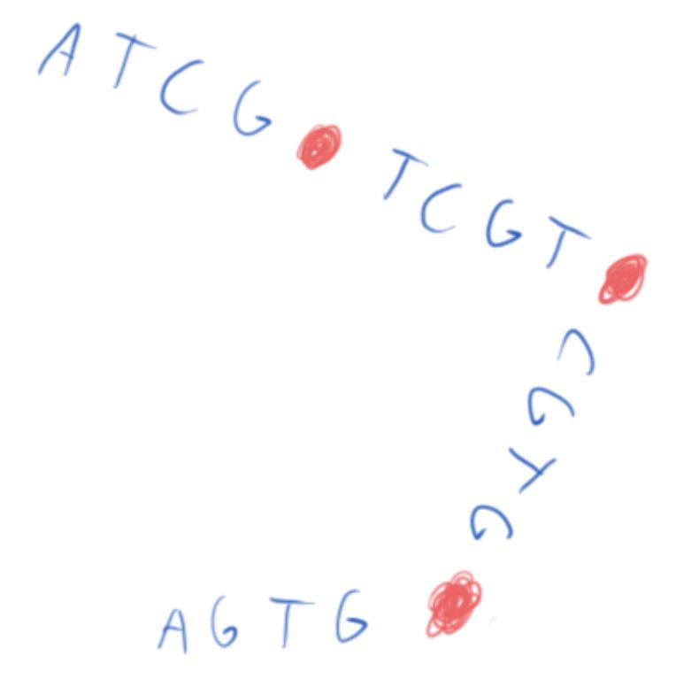
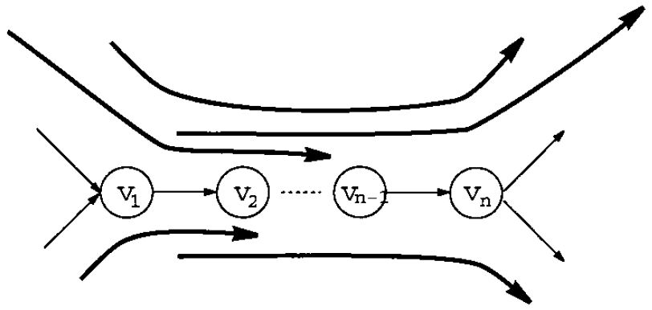
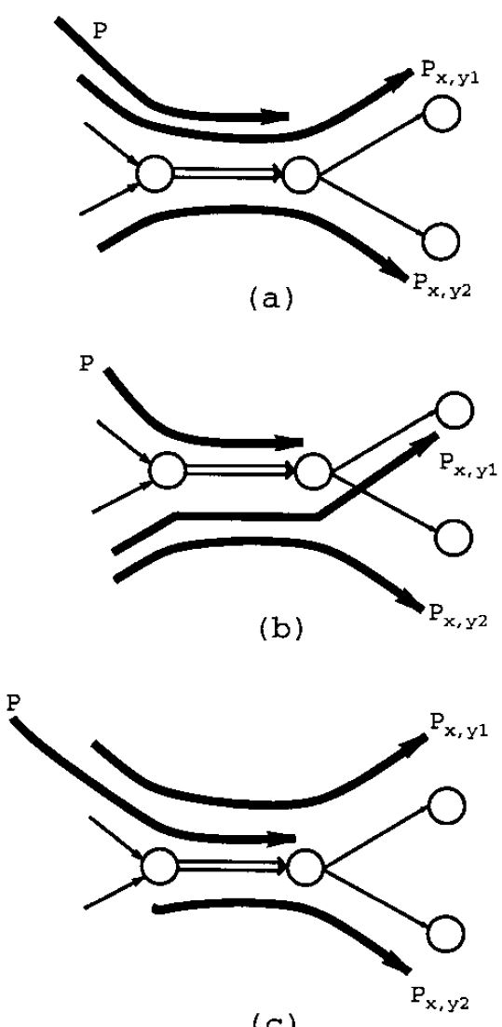
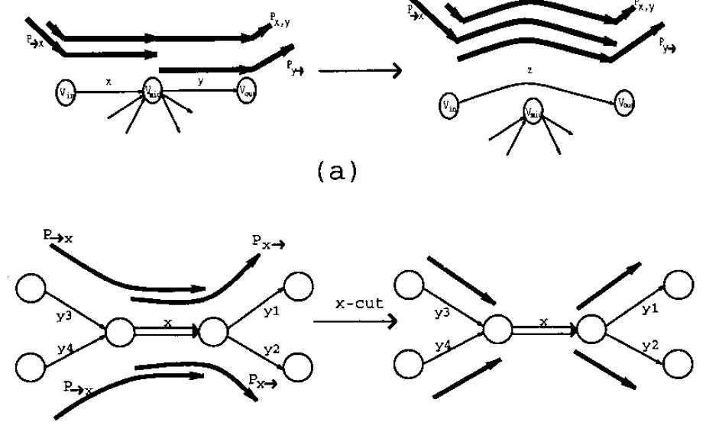
Overlap-layout-consensus (Hamiltonian)
Problem: constructing de Bruijn graph not trivial; errors and repeats are problem.
de Bruijn Graph (Eulerian)
To correct sequencing errors, need sequence (don’t have)
Idea: align to n-tuples of the sequence
Spectral Alignment Problem
Create Eulerian Superpath
Scaffolding
http://www.ncbi.nlm.nih.gov/pmc/articles/PMC55524/

Slide 4
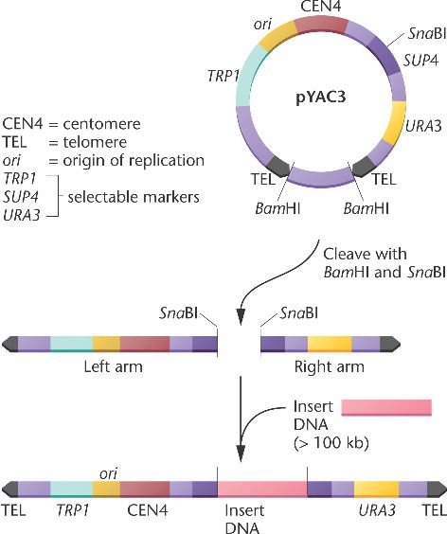
Bacterial/Yeast Artificial Chromosomes and genomic linkage
BAC : Circular DNA construct containing a short DNA insert of ~150 - 350 kb, amplified, then isolated and sequenced
YAC: linear, can contain larger inserts (2000 kb +), but prone to recombination
DNA amplification in artificial chromosomes key to early efforts to sequence the human genome

Slide 5
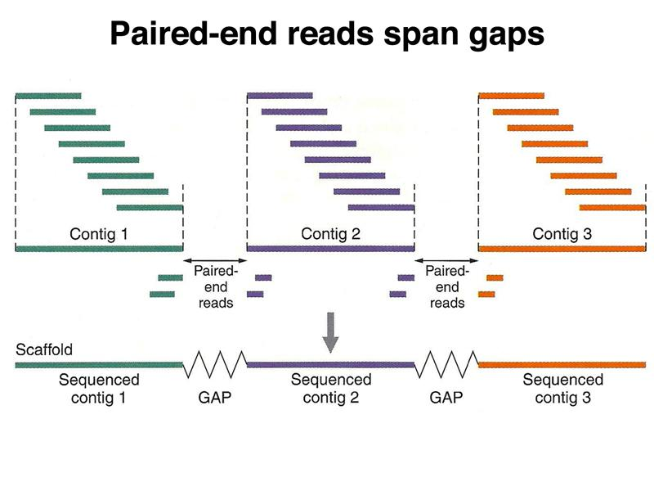
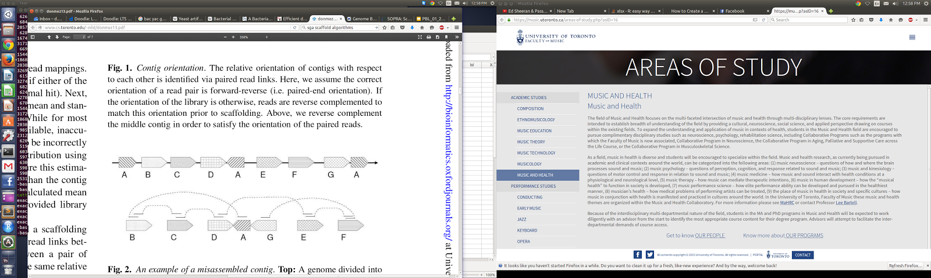
Scaffolding algorithms
Genome Assembly (2 Steps):
Contig assembly
Join contigs into scaffolds according to a scaffolding algorithm using info from paired-end / mate pair reads (ordering + orienting contigs)
Paired end reads - enzymatically isolate, sequence both ends of a long DNA molecule
Known distance + relative orientation of each end
Scaffolding: Order the contigs such that you maximizes supporting paired reads
Bambus (2004) : used a greedy algorithm (joined contigs with most links, ignoring subsequent, conflicting edges)
Newer algorithms represent the problem as a graph (nodes = contigs, edges = paired end links): SOPRA (2010), SGA (2012), SCARPA (2012)

Slide 6
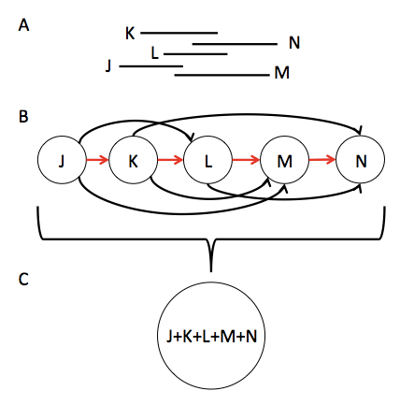
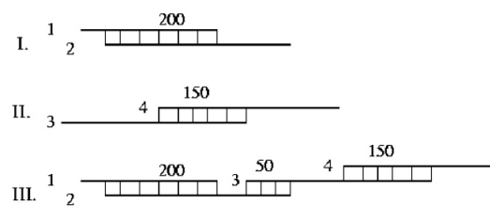
Greedy Algorithms
Overlap-Layout-Consensus

Slide 7
References:
Greedy Algorithms: Pop, M., Salzberg, S. L., & Shumway, M. (2002). Genome sequence assembly: Algorithms and issues. Computer, 35(7), 47-54. (https://www.eecis.udel.edu/~shatkay/Course/papers/PopEtAlAssemblyOverview.pdf)
OLC: Lecture set from JHU: http://www.cs.jhu.edu/~langmea/resources/lecture_notes/assembly_olc.pdf Taylor, D. L., Heyer, L., Campbell, A. M., Denham, S., & Wessner, D. (2012). PHAST (Phage Assembly Suite and Tutorial): A Web-based Genome Assembly Teaching Tool (Doctoral dissertation, Davidson College). (http://gcat.davidson.edu/phast/docs/Thesis_PHAST_LelandTaylor.pdf)

Slide 8
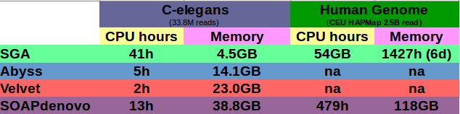
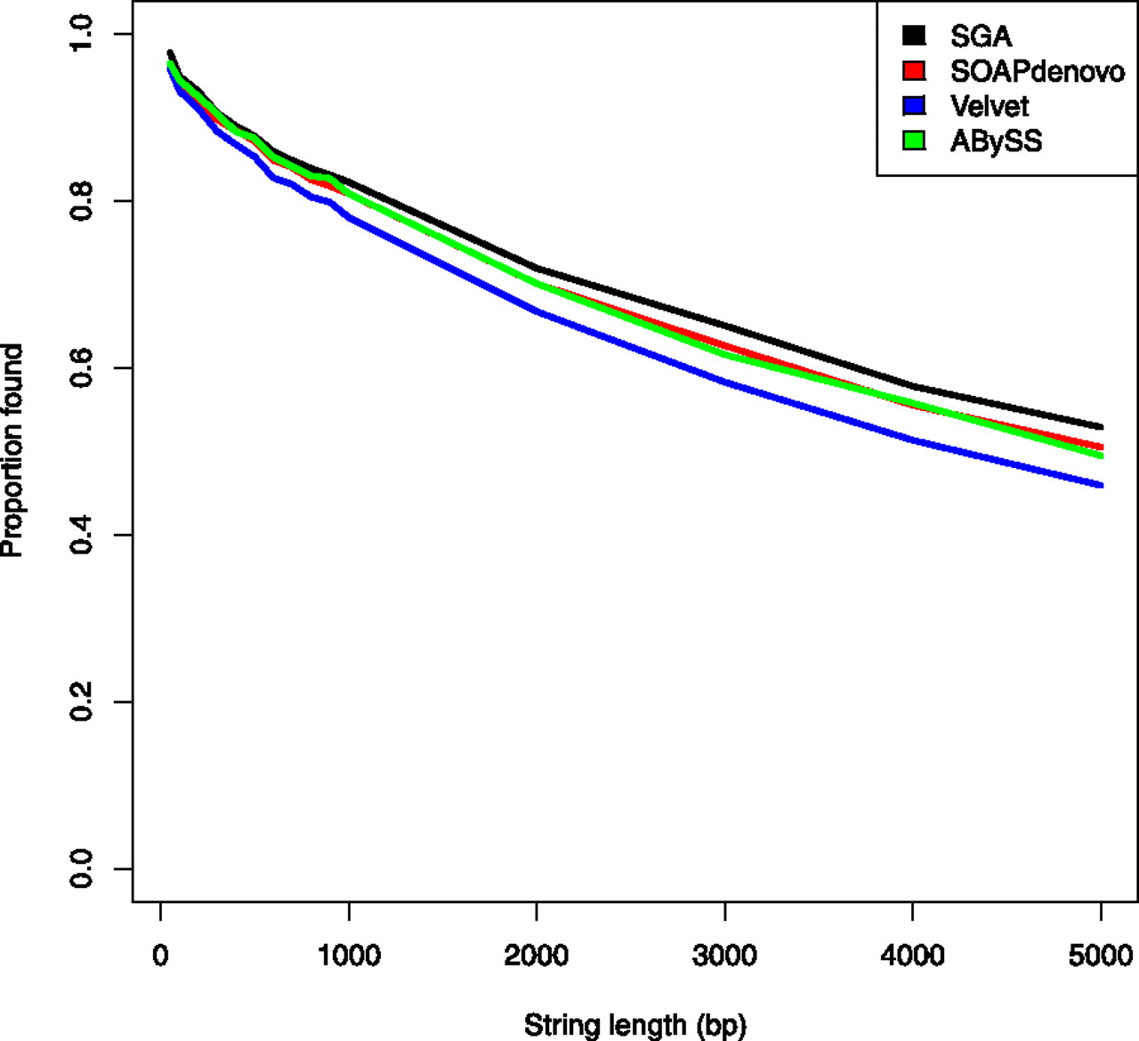
String Graph Assembler (SGA)
Correction
Computational performance:
FASTQ
reads
SGA FM index
SGA correct
Corrected FASTQ reads
Assembly
SGA FM index
SGA filter
SGA assemble
Contigs-String Graph
Scaffold
BWA Align
FASTA
SGA scaffold
SGA scaffold2fasta
Reference string coverage analysis for the C. elegans N2 assembly.
Notes:
Jared T. Simpson, and Richard Durbin,Efficient de novo assembly of large genomes using compressed data structures
Software: https://github.com/jts/sga.

Slide 9
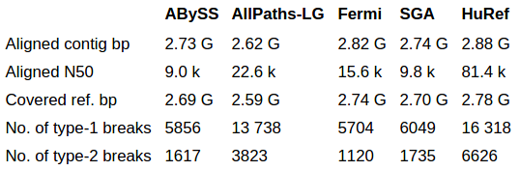
Fermi: de novo assembler for Illumina reads from WGSS
Substantially influenced by SGA Idea :contrasting read sets
Assembles Illumina short reads into unitigs
Provides error correction, sequence-to-read alignment and comparison between read sets
Bi-directional FMD-index(forward and reverse strand DNA sequences in one index)
On a 35-fold human resequencing data, similar accuracy for SNP calling,better results for INDEL calling by aligning the fermi unitigs to the reference genome
12 CPUs and 96 GB memory in ~5 days Peak memory usage ~ 92 GB.
Statistics on human whole-genome assemblies
Notes:
Heng Li,Medical Population Genetics Program, Broad Institute, 7 Cambridge Center, MA 02142, USA
Exploring single-sample SNP and INDEL calling with whole-genome de novo assembly
Note:The idea of contrast assembly, assembles reads containing a k-mer that is present in one set of reads but absent from another set of reads. The contigs we get this way will span variants, including mutations and breakpoints, only seen from the first set of reads. Mapping the contigs back provides the locations. This approach directly focuses on the differences between read sets and helps to reduce the complication of structural variations and the imperfect reference genome.

Slide 10
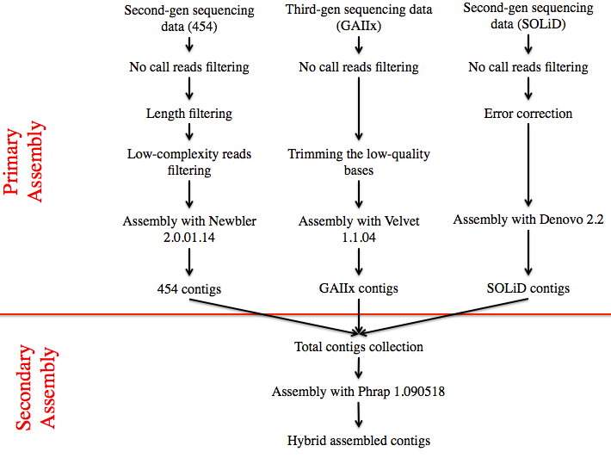
Hybrid
Assembly
Notes:
The principle of hybrid assembly is still intuitive as it still follows the same idea of assembly. Assemblers look for reads that overlap, and contigs that overlap with each other. Hybrid assembly is just looking for overlaps from contigs from different sources. Originally hybrid assembly simply meant combining the data from different sequencing platforms. At some point, people did like to refer to it as assembly based on different assemblers. Now, it’s a bit more specific as it refers to combining second gen sequencing and third-gen sequencing. This is because second-gen sequencing and third-gen sequencing (or single molecule sequecinging) can complement each other weaknesses. Second generation sequencing technology has short reads that make it difficult to characterize the repeated sections of the genome. Third generation can complement this because of their long reads. They’re better at finding overlaps. However, third gen cannot be used because it has a high error rate. Second generation sequencing’s short reads can help identify these errors. In essence, the approach of hybrid assembly is similar to how de novo assembly is done with a single sequencer except with multiple sequencers. When the contigs of each platform has been form, they are collected into a single group and assembled. Of course, the secondary assembly can be done using the assembly algorithms that we just discussed. The image here is from a study by Wang et al., where they assembled a microbe genome. In terms of algorithms, since you’re using multiple assemblers, it also means you can take advantage of different assembly algorithms. For example, the differing lengths of OLC reads can be complemented by the set scope of k-mer reads, making for a more accurate. Another way hybrid assembly is done using the algorithms we have at our disposal is based on an assembler called Cerulean.
Examples of Assembler: Taipan, Cerulean
De Brujen: Traditionally uses this approach as it focuses on a spectrum of lengths.
Strengths: One study (by Koren et al.,) showed that using a lower coverage of corrected long reads corrected by short reads is similar to using a higher coverage of shorter reads
Weaknesses: More expensive, more time/resource consuming.

Slide 11
Error Correction
(Sequencing Methods)
Degree of contiguity (coverage gaps)
Higher coverage (>50 x) (HGAP, PacBioToCA, short read assemblers)
Long Reads
Short Reads
Use short range paired reads to make pre-assembled UNITIGS (PBcR + Celera) – still hybrid, though ‘self correcting’
Shorter SMRT reads within longer ones (HGAP). High coverage needed.
Test range of k-mers (Velvet)
Adapt for low coverage regions – use a smaller value of K (ALLPATHS-LG)
Extend contigs using mate pair information (ABySS)
Generate supercontigs (gapped contigs) using OLC method (Forge)
Correctness of assembly (base calling errors, low coverage resolution, repeats)
Remove low quality reads, ones with N’s, short reads (<100 bp), ones with high error probability bases, ‘chastity filter’
Long Reads
Short Reads
No GC bias (doesn’t require PCR amplification)
Read Length > Repeat Length; spans homopolymers, palindromes;
Add PhiX phage DNA to calibrate sequence quality scores (Illumina)
Remove dead end paths (Base calling errors)
Remove or merge divergent bubbles (polymorphisms and inserts)
Collapse repeats, compare 24-mer stacks in reads (ALLPATHS-LG)
Notes:
Sequencing errors and correction (Jasleen)

Slide 12
References
Ekblom, R & Wolf, JBW. A field guide to whole-genome sequencing, assembly and annotation (2014). Evolutionary Applications 7:1026-1042.
Baker, M. De novo genome assembly: what every biologist should know (2012). Nature Methods: 9.4:333-337.
Technical note: Illumina Sequencing (https://www.illumina.com/Documents/products/technotes/technote_denovo_assembly_ecoli.pdf)
Chin, CS et al. Nonhybrid, finished microbial genome assemblies from long-read SMRT sequencing data (2013). Nature Methods: 10.6: 563-569. doi: 10.1038/NMETH.2474
Koren, S et al. Hybrid error correction and de novo assembly of single-molecule sequencing reads (2012). Nature Biotechnology 30:693-700. doi: 10.1038/nbt.2280
Loman, N et al. A complete bacterial genome assembled de novo using only nanopore sequencing data (2015). Nature Methods: 12.8: 733-735. doi: 10.1038/NMETH.3444
Zerbino, D. Using the Velvet de novo assembler for short-read sequencing technologies (2010). Curr Protoc Bioinformatics: 11.5. doi: 10.1002/0471250953.bi1105s31
Notes:
Sequencing errors and correction (Jasleen)

Slide 13
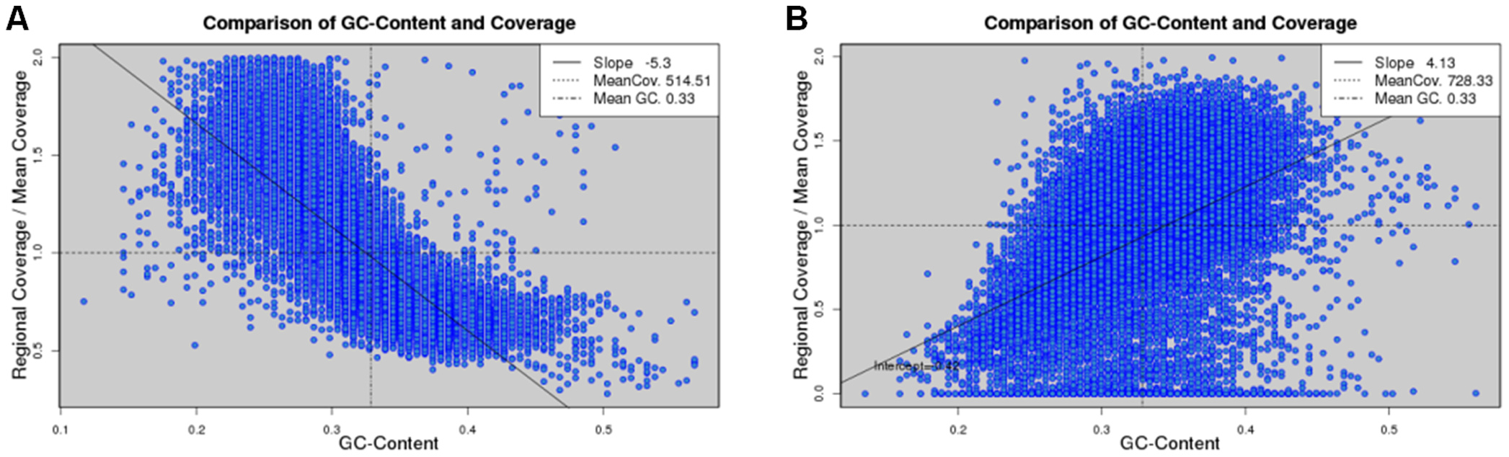
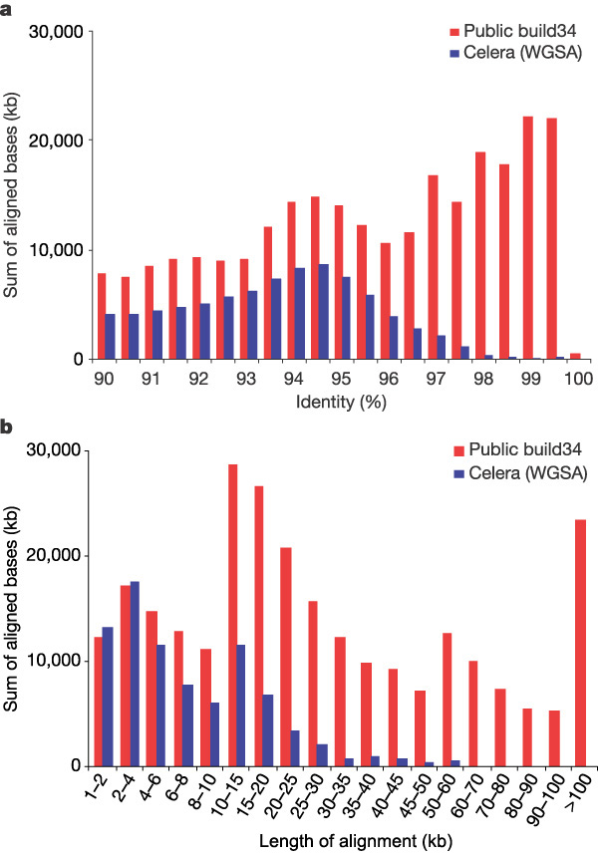
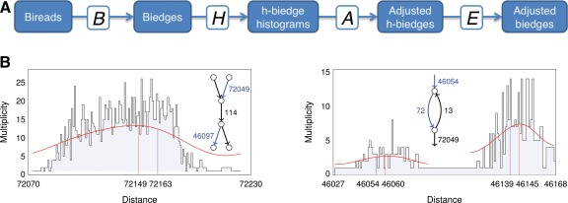
clone-ordered sequence
WGSA data only
NGS Assemblers do not account for variable coverage well
Velvet, ALLPATHS, SOAPdenovo, Euler-__, ABySS (Dr. Birol)
Possible Solutions:
Normalize read coverage (NeatFreq)
Sliding window to filter out sequencing bias (SWA)
Bireads (SPAdes, Dr. Pevzner)
Ekblom, R., Smeds, L., & Ellegren, H. (2014). Patterns of sequencing coverage bias revealed by ultra-deep sequencing of vertebrate mitochondria. BMC Genomics, 15(1), 467. doi:10.1186/1471-2164-15-467
Chen, Y.-C., Liu, T., Yu, C.-H., Chiang, T.-Y., & Hwang, C.-C. (2013). Effects of GC bias in next-generation-sequencing data on de novo genome assembly. PloS One, 8(4), e62856. doi:10.1371/journal.pone.0062856
She, X., Jiang, Z., Clark, R. A., Liu, G., Cheng, Z., Tuzun, E., … Eichler, E. E. (2004). Shotgun sequence assembly and recent segmental duplications within the human genome. Nature, 431(7011), 927–30. doi:10.1038/nature03062
Sims, D., Sudbery, I., Ilott, N. E., Heger, A., & Ponting, C. P. (2014). Sequencing depth and coverage: key considerations in genomic analyses. Nature Reviews. Genetics, 15(2), 121–32. doi:10.1038/nrg3642
Bankevich, A., Nurk, S., Antipov, D., Gurevich, A. A., Dvorkin, M., Kulikov, A. S., … Pevzner, P. A. (2012). SPAdes: a new genome assembly algorithm and its applications to single-cell sequencing. Journal of Computational Biology : A Journal of Computational Molecular Cell Biology, 19(5), 455–77. doi:10.1089/cmb.2012.0021
Notes:
CNVs, SegDups, Coverage Bias (GC etc.) (Sam)

Slide 14
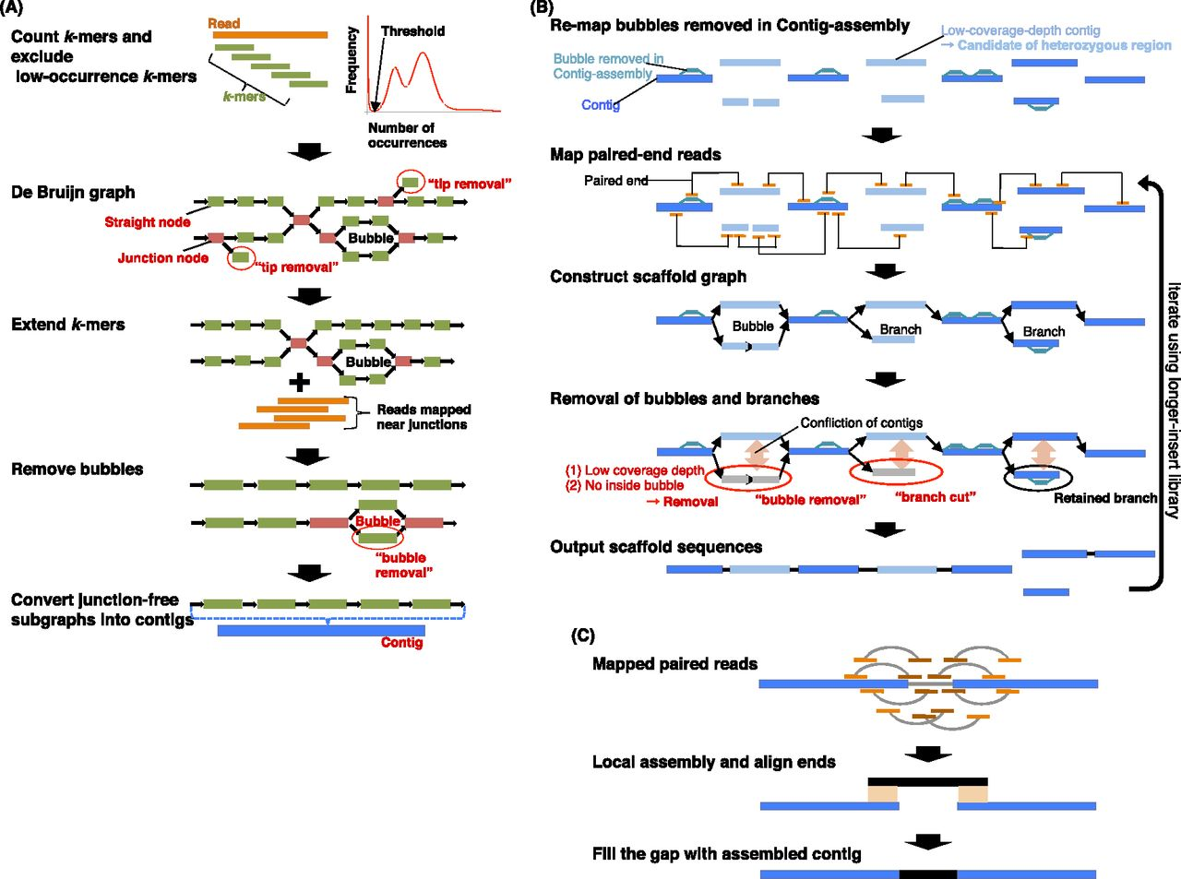
Kajitana 2014
Notes:
Schematic overview of the Platanus algorithm. (A) In Contig-assembly, a de Bruijn graph is constructed from the read set. Short branches caused by errors are removed by “tip removal.” Short repeats are resolved by k-mer extension, in which previous graphs and reads are mapped to nearby k-mers at the junctions. Finally, bubble structures caused by heterozygosity or errors are removed. Subgraphs without any junctions represent contigs. (B) In Scaffolding, links between contigs are detected using paired reads. The relationship between contigs is represented by the graph. Bubbles removed in Contig-assembly are remapped on contigs and utilized for mapping of paired-end reads and detection of heterozygous contigs. Heterozygous regions are removed as bubble or branch structures on the graph by the “bubble removal” or “branch cut” step. These simplification steps are characteristic of Platanus and especially effective for assembling complex heterozygous regions. (C) In Gap-close, paired reads are mapped on scaffolds, and reads mapped at nearby gaps are collected for each gap. If a contig is expected to cover the gap and is constructed from collected reads, the gap is closed by the contig.

Slide 15
References:
Kajitani R, Toshimoto K, Noguchi H, Toyoda A, Ogura Y, Okuno M, et al. Efficient de novo assembly of highly heterozygous genomes from whole-genome shotgun short reads. 2014;1384–95.

Slide 16
Issues with Repeats in Assembly
Tandem Repeats
Homopolymers - AAAAAAA
Polynucleotide - AGAGAG Causes small cycles in graph assembly
Interspersed Repeats
LTRs, SINEs and LINEs
Palindromes
5’-GAATTC-3’
3’-CTTAAG-5’
Causes graph assembly fold onto itself Velvet requires that k-mers be odd-numbered
CATATATATATAG
R1R2
CATAT
ATATA
TATAT
ATATG
Notes:
Two categories of repeats: tandem repeats and interspersed repeats. The two types are not mutually exclusive.
Split tandem repeats into two categories: homopolymer and polynucleotide.
Homopolymers are repeats of a single base-pair while polynucleotide are repeats of sequences containing more than one base pair
Tandem repeats induce small cycles within the assembly graph
Solution in this case could be increase the k-mer size but increases memory load. Also can’t use this solution when the repeat is longer than fragment length.
Another solution is to use paired-end reads that span the repeat region. This is also bound by the maximum read length of the sequencing technology
Interspersed repeats are near identical sequences that are separated unique intervening sequences.
These types of repeats produce a frayed rope topology in the graph assembly
The solution is to use long reads to bypass the span the repeat region. Again this solution is bound by read length.
Palindromes are sequences that are identical on both strands of DNA when read 5’ to 3’.
Causes the assembly to fold onto itself
Velvet gets around palindromes by requiring that k-mers be odd-numbered.

Slide 17
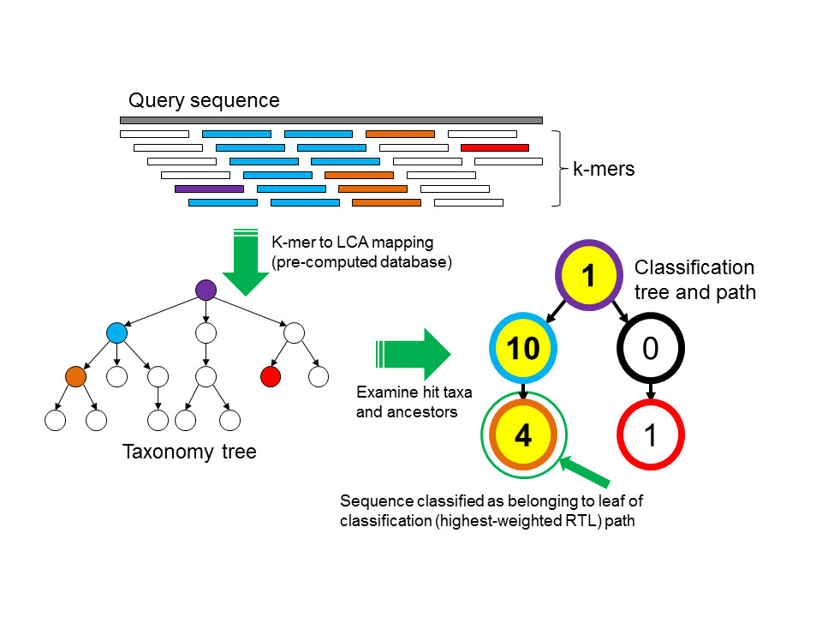
k-mer based method
alignment based method
Assemble reads
BLAST contigs to identify sources of contamination, or guess a priori
repeat as desired
Map raw reads to genomes of identified contaminants

